Slide 1
Methamphetamine (Meth) Use Classification
David Nnamdi
July 1, 2022

Slide 2
Project Definition
Motivation
In recent years, deaths in the U.S from meth overdose has risen (NIH, 2021)
Investigation of factors that can be indicative of likely meth usage required
Project Objectives
Feature selection to identify key predictors out of over 2000+ features
Explore different sampling techniques for dealing with data imbalance and its effects on model performance
Create a well-tuned Machine Learning model(s) that classifies an adult with substance abuse history as a Meth user
Define Simple rules for meth usage identification amongst persons with substance abuse history
Personal Objectives
Understand interdependency of substance abuse
Utilize AutoML tools
Advisor: Prof. Brian Fiedler

Slide 3
Data Ingestion
The data was obtained from 2020 National Survey on Drug use and Health (NSDUH) available here
Data stored as tab delimited file initially processed into a csv file for further use
Initial Dataset consisted of 32893 row entries and 2889 columns with a total size of over 725 megabytes
Each row entry corresponded to an individual user survey and each column represents answers to a specific question in the survey
These answers are either entered directly by users, logically assigned based on prior input, or imputed based on NSDUH predefined modified predictive mean Neighborhood, modPMN (SAMHDA, 2022)

Slide 4
Data Exploration – QUESTION GROUPS
The data consists of 3 major question groups each with subgroups
Group 1 (Self-Administered Substance Abuse)
Substance abuse history
Recency of substance abuse
Group 2 (User Demographics)
Base Demographics Info e.g., Age, Gender, Sex, Military history etc.
Education
Employment
Health Insurance
Income
Group 3 (Geographic Info)
County Info
Segment & Block (Indian tribal lands)

Slide 5
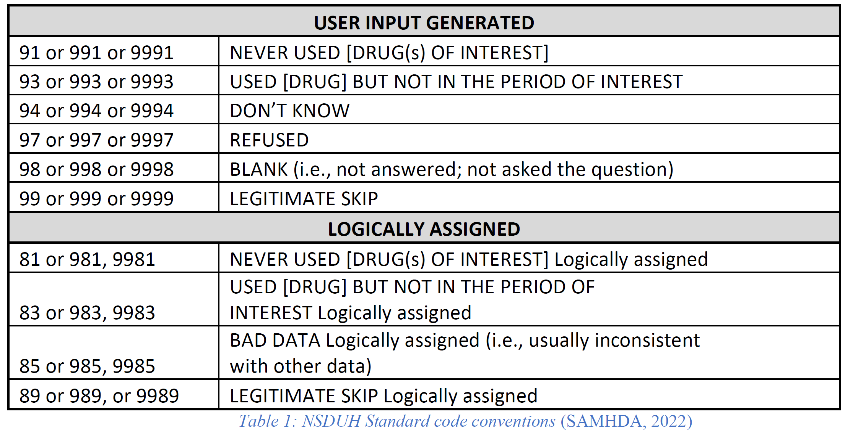
Data Exploration – STANDARDIZED ANSWERS
NSDUH represented answers to questions (user specific, logically assigned, and imputed) with numerical variables to standardize interpretation of answers
Table 1 below details a high-level (albeit not comprehensive) summary of numerical variables and their implied meanings
Sections that deal with user demographics, mental health and other specific questions have separate encodings; user age is also either entered as actual age or is binned and assigned a specific encoding

Slide 6
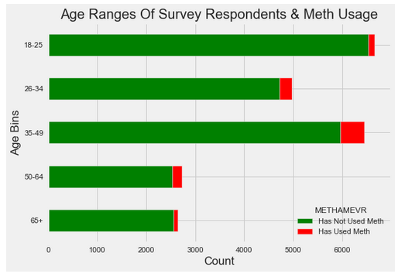
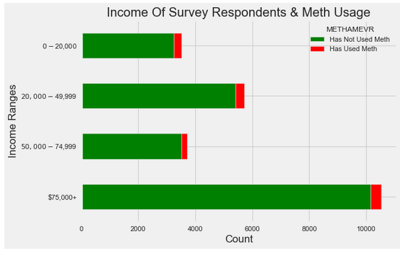
Data Exploration - DEMOGRAPHICS

Slide 7
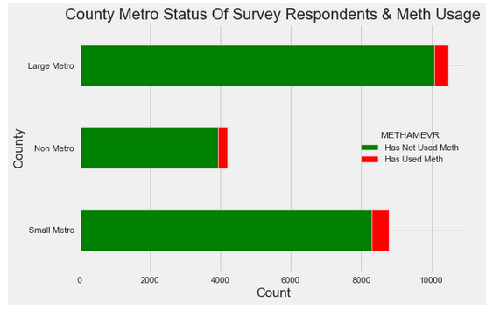
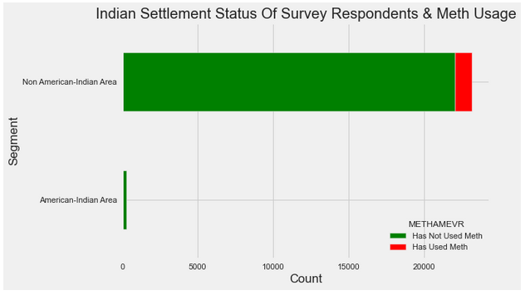
Data Exploration - GEOGRAPHIC

Slide 8
Data Preparation – ATTRIBUTE SELECTION
Detailed review of the NSDUH codebook revealed that a lot of the questions asked in the survey were redundant and the same information could be represented by answers in one question
Some basic examples of these redundant questions include:
Age when first used cocaine vs Year of first cocaine use
# Days used cocaine past 30 days vs Best estimate # Days used cocaine past 30 days
Other examples are drawn from substance use with several variants e.g.,
Hallucinogens include Ecstasy, LSD, PCP, Ketmine etc.
Inhalants include Amyl nitrite, Nitrous oxide, spray paints, correction fluid, aerosol sprays etc.
These selection help in reducing the number of attributes selected for modeling to 158

Slide 9
Data Preparation – SUBSETTING & FACTOR COLLAPSING
Sub-setting
All rows where prediction target answers were not specifically defined as Yes or No dropped
All rows of all columns where code ϵ {85, 94, 98}. (Refer to table 1 for details) dropped
Under 18 substance abusers dropped
Factor Collapsing
User answers with code 91, 93, 81 and 83 are assigned the encoding for the answer “No”
User answers with code 99 and 89 are collapsed into a single factor ‘skip’
User Age binned into 6 ranges between 18 yrs. and 65+
All age-related recency of first used data collapsed into “Less than 18” and “18 or older”

Slide 10
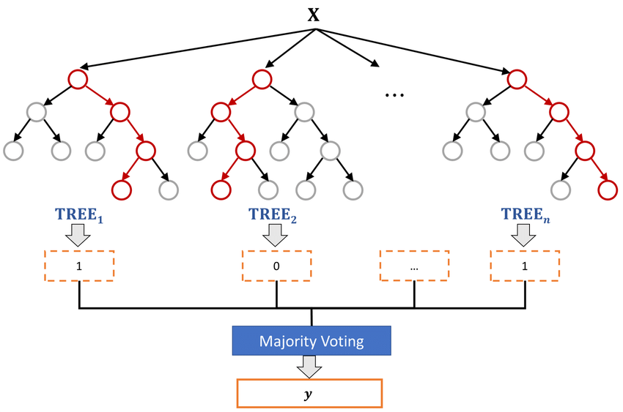

Model Design and Validation
Model Selection
The prediction of meth users was modeled as an imbalanced classification problem
3 sampling techniques explored to deal with data imbalance
Under sampling (the majority class, i.e., non-meth users)
Oversampling (the minority class, i.e., meth users)
SMOTE sampling
Several supervised learning techniques applied but preference given to tree-based ensembles
Tree-based ensembles provide Variable Importance Scores (VIS) based on feature influence on correct classification
Final model selection based on key performance metrics for imbalanced classification
AUPRC
F1-Score
Recall (or Sensitivity)

Slide 11
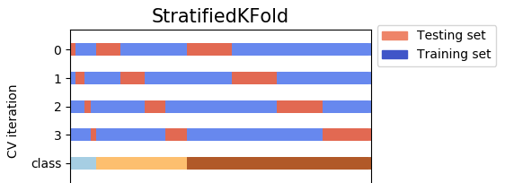
Model Design and Validation
Process Validation
Utilized stratified k-fold cross validation (k=10) techniques to ensure class distribution is maintained during splits and overfitting issues are reduced during training
70/30 train-test splits with random state = 123 chosen across all splits and for all sampling techniques ensure comparability and reproducibility
Further Exploratory Analysis done on top features of best models to derive simple classification rules (As prescribed by Prof. Brian Fiedler)
Modelling approach shares some similarities with Imbalance Random Forest methods classification by (Beattie & Nicholson, 2020)

Slide 12
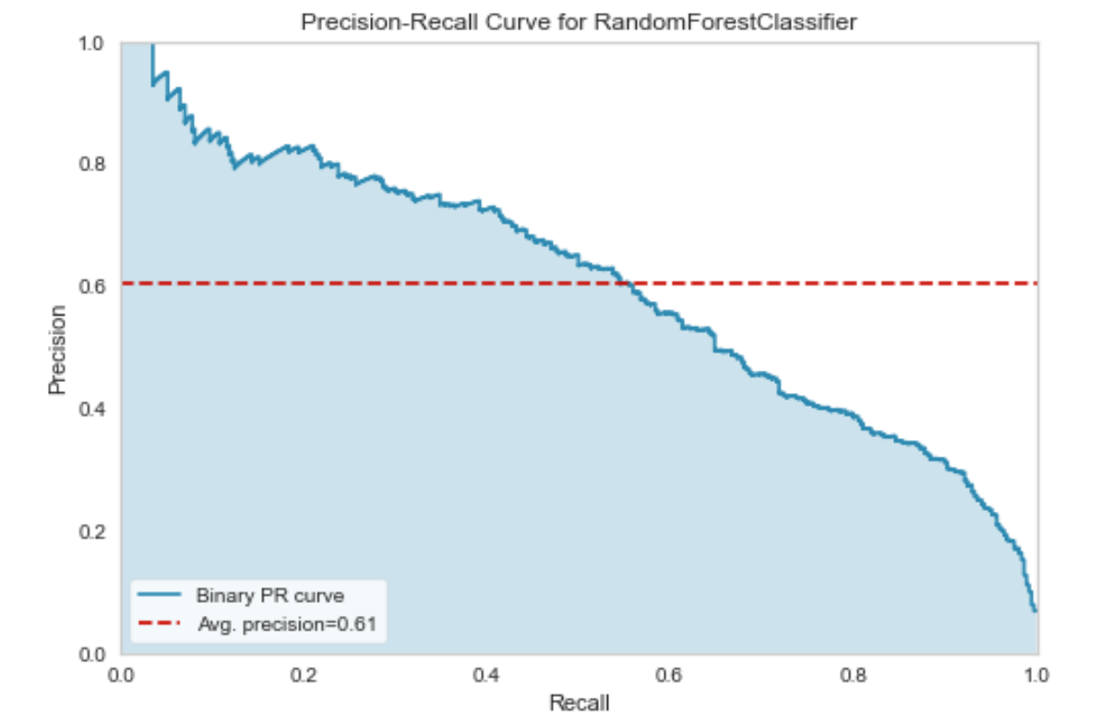
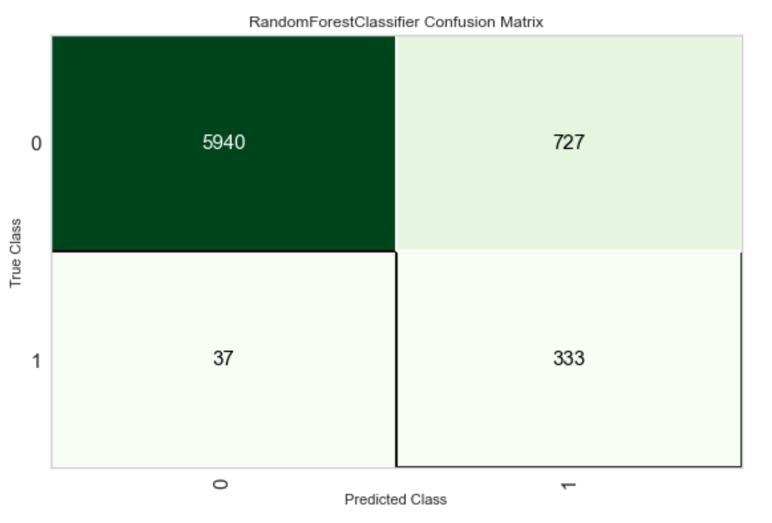
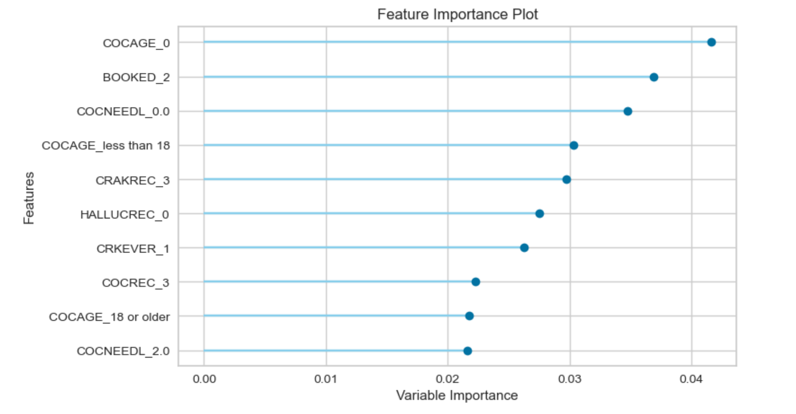
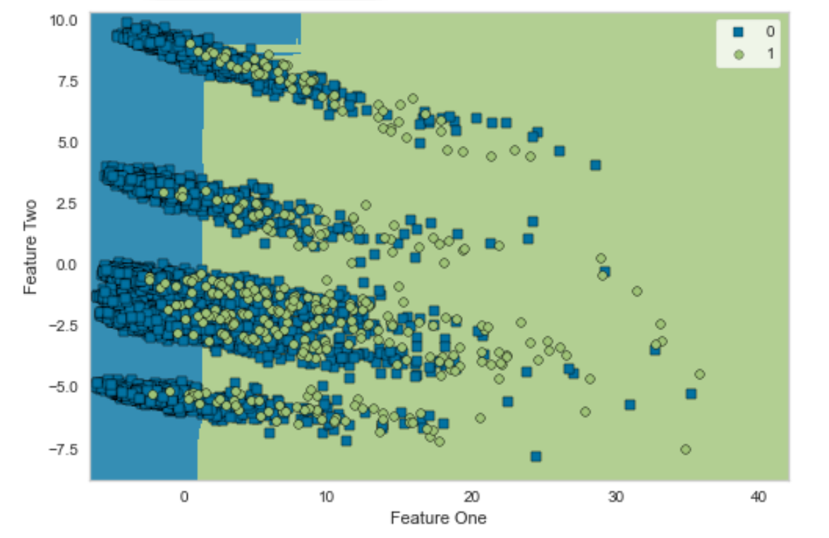
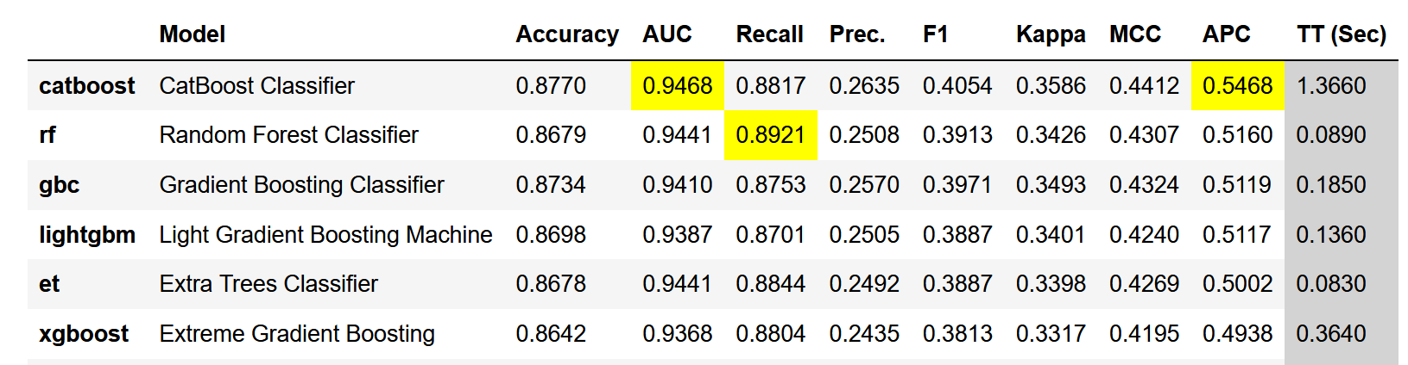
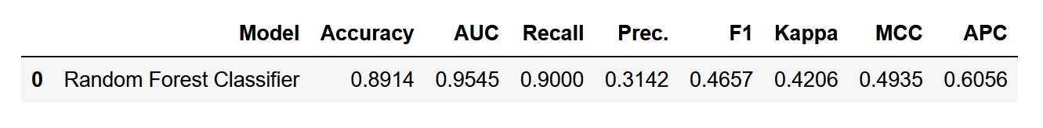
Model Results – UNDER SAMPLING
OneHot Encoding used for all 157 categorial features
Original Data (23454, 158)
Transformed Train set (16417, 620)
Transformed Test set (7037, 620)
Data Trained using several methods and performance ranked based on AUPRC score
CatBoost Classifier Best on initial training
Random Forest second best
Model Tuning achieved with Randomized GridSearch with cross-validation
Random Forest Best performing post-tuning
RF Model Metrics on Test Data Post-Tuning
Model Metrics Pre-Tuning

Slide 13
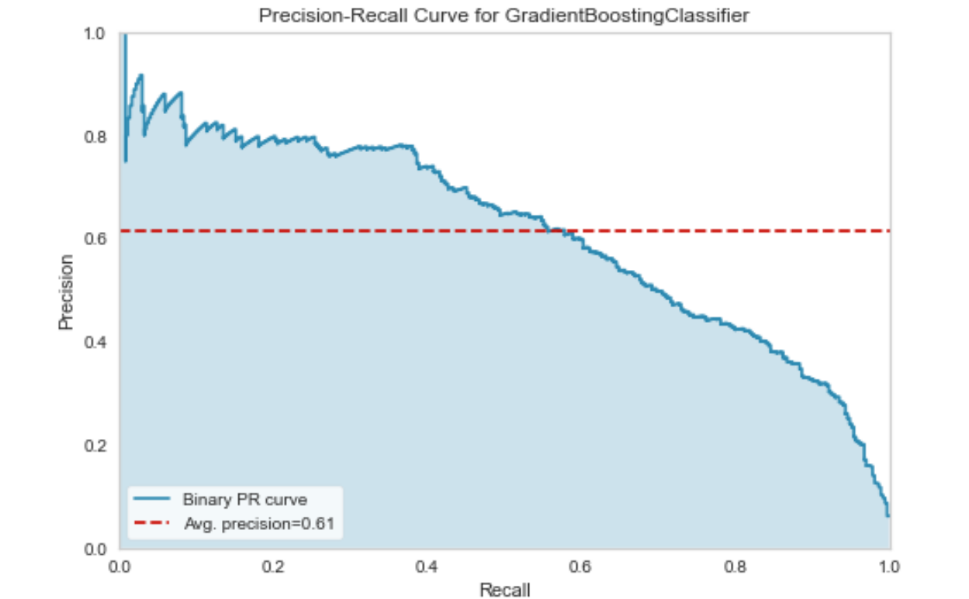
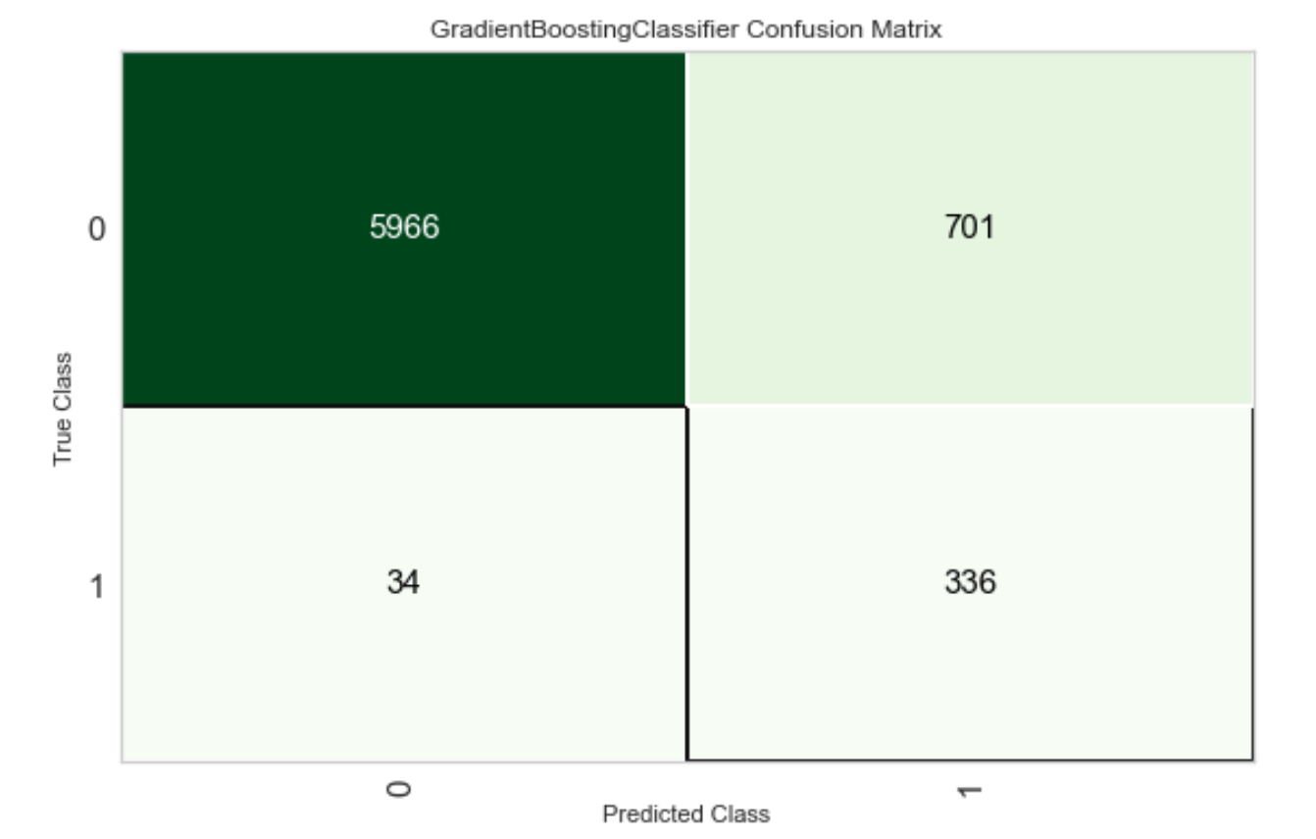
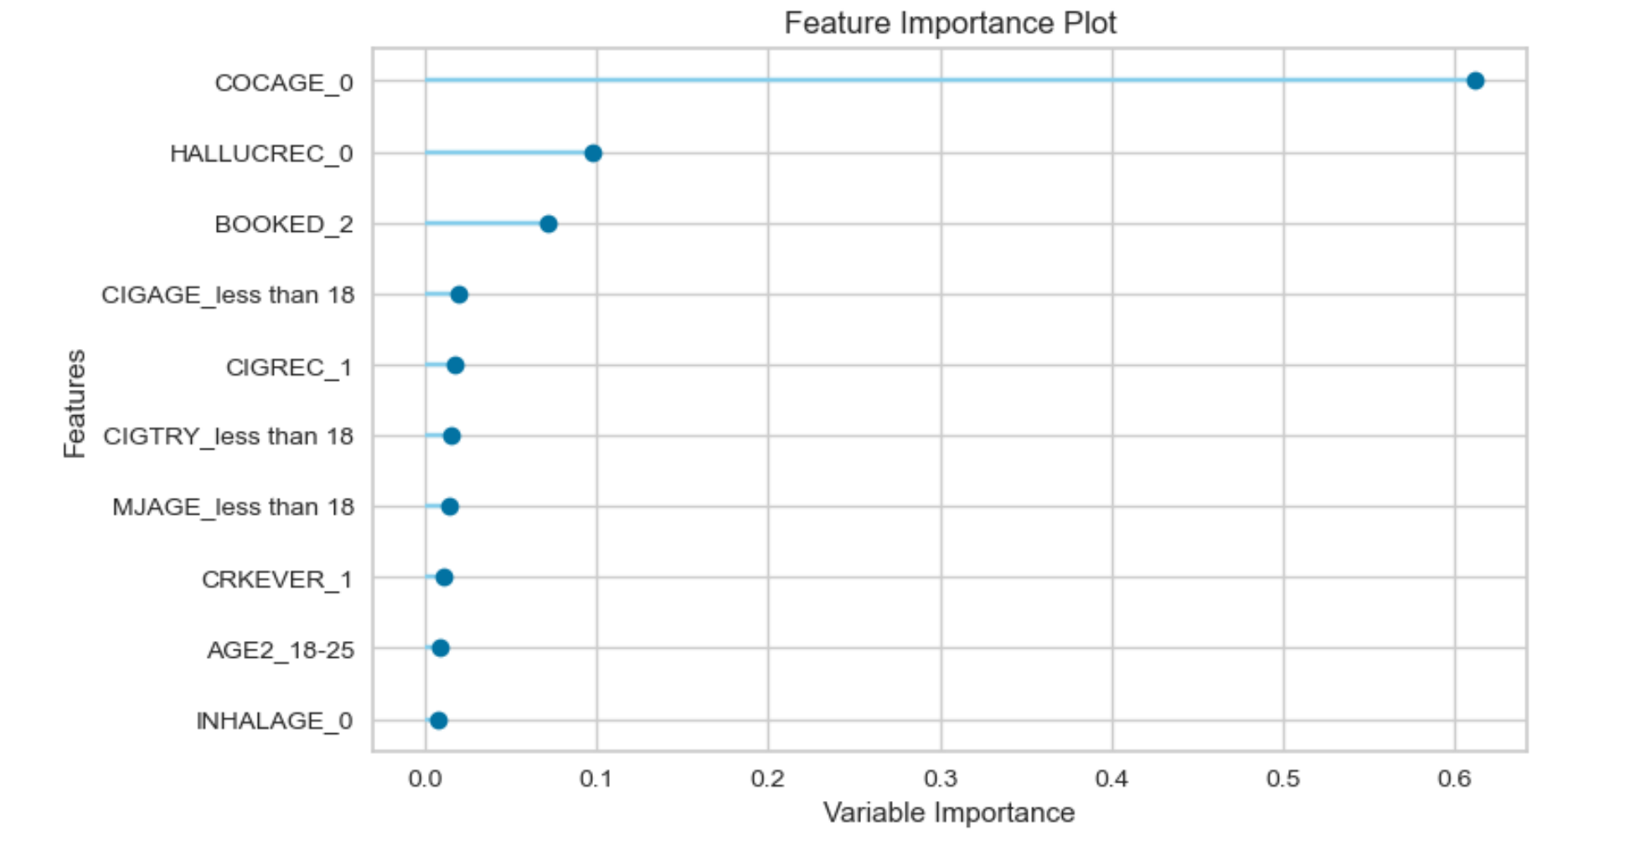
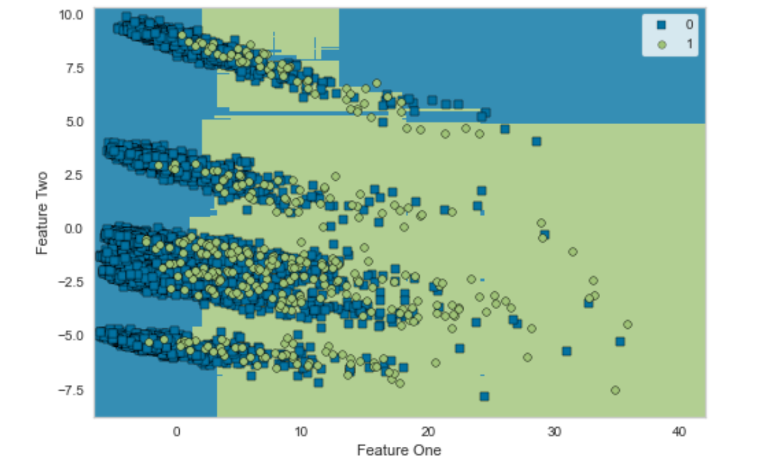
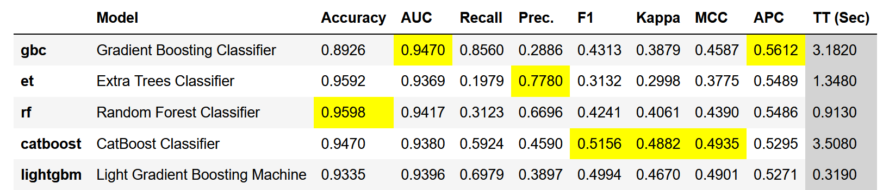
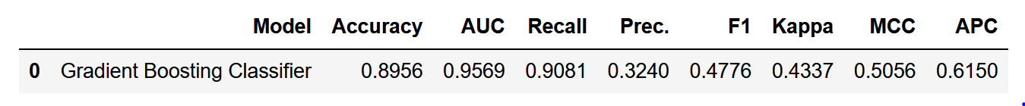
Model Results – OVER SAMPLING
Data Trained using several methods and performance ranked based on AUPRC score
Gradient Boosting Classifier Best on initial training
Extra Trees Classifier second best
Random Forest third best
Model Tuning achieved with Randomized GridSearch with cross-validation
Gradient Boosting Classifier pre-tune better than Other Models Post-tune
Model Metrics Pre-Tuning
GBC Model Metrics on Test Data Pre-Tuning

Slide 14
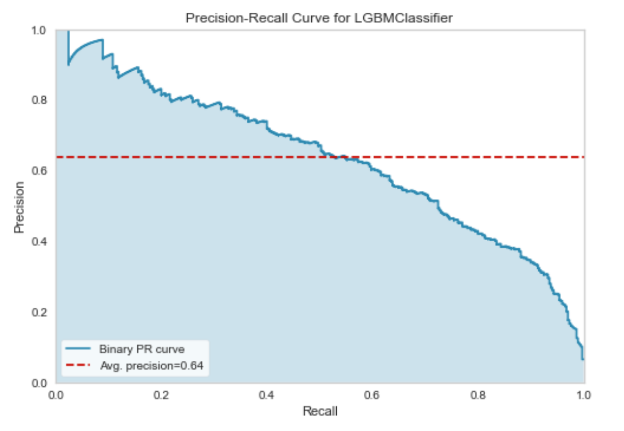

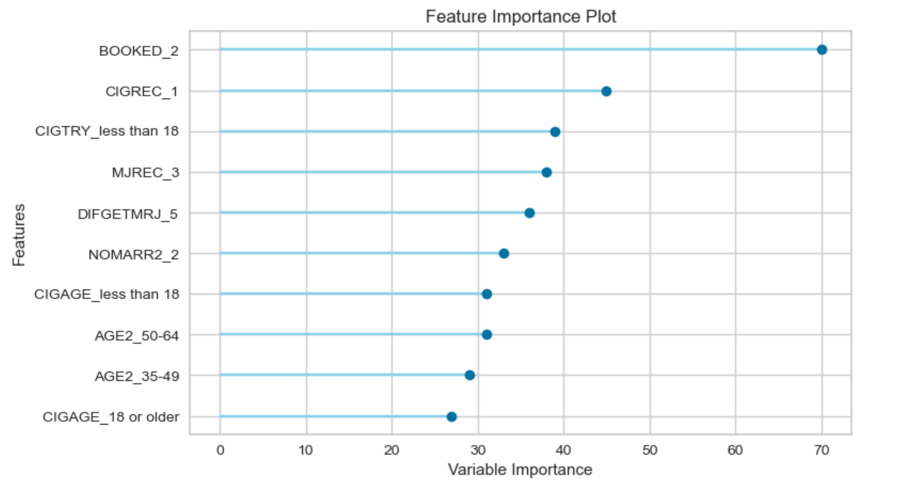
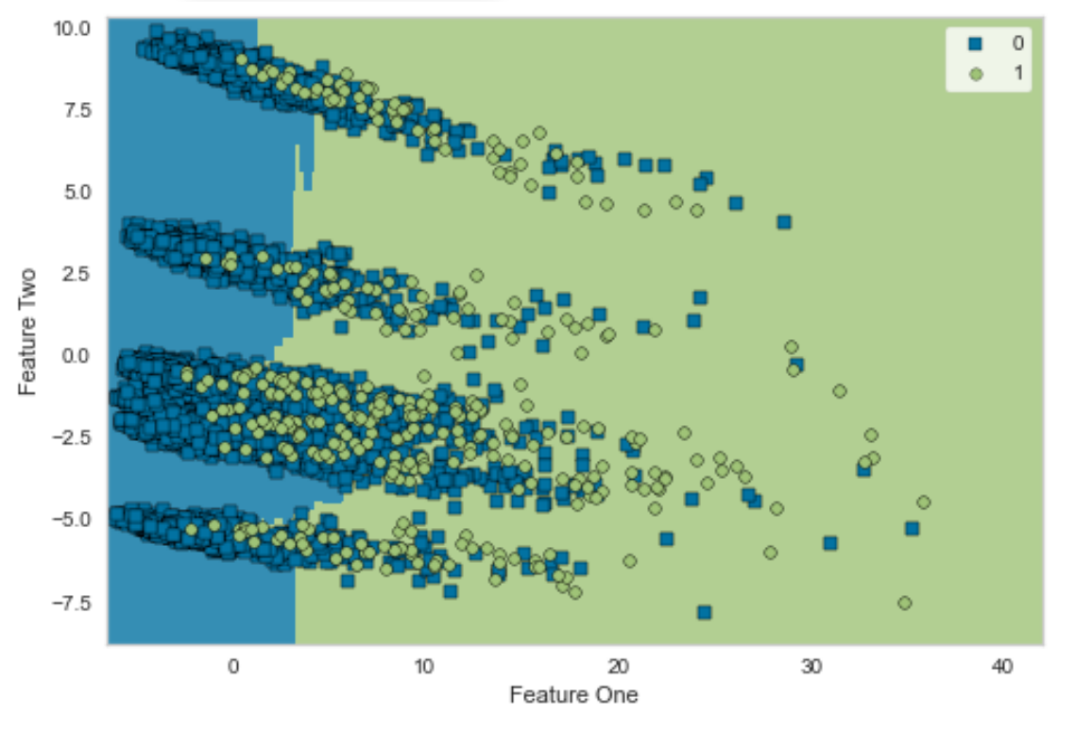
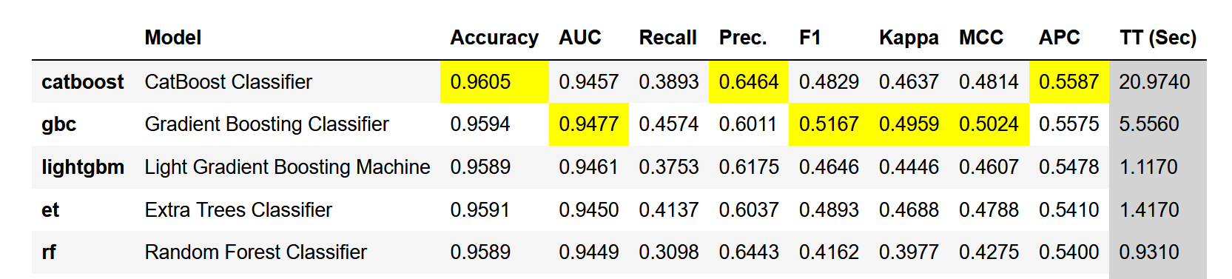
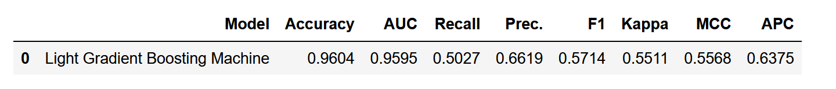
Model Results – SMOTE SAMPLING
Data Trained using several methods and performance ranked based on AUPRC score
CatBoost Classifier Best on Initial Training
Gradient Boosting Classifier second best
Light GBM third best
Model Tuning achieved with Randomized GridSearch with cross-validation
Light GBM Best performing post-tuning
Model Metrics Pre-Tuning
LightGBM Model Metrics on Test Data Post-Tuning

Slide 15
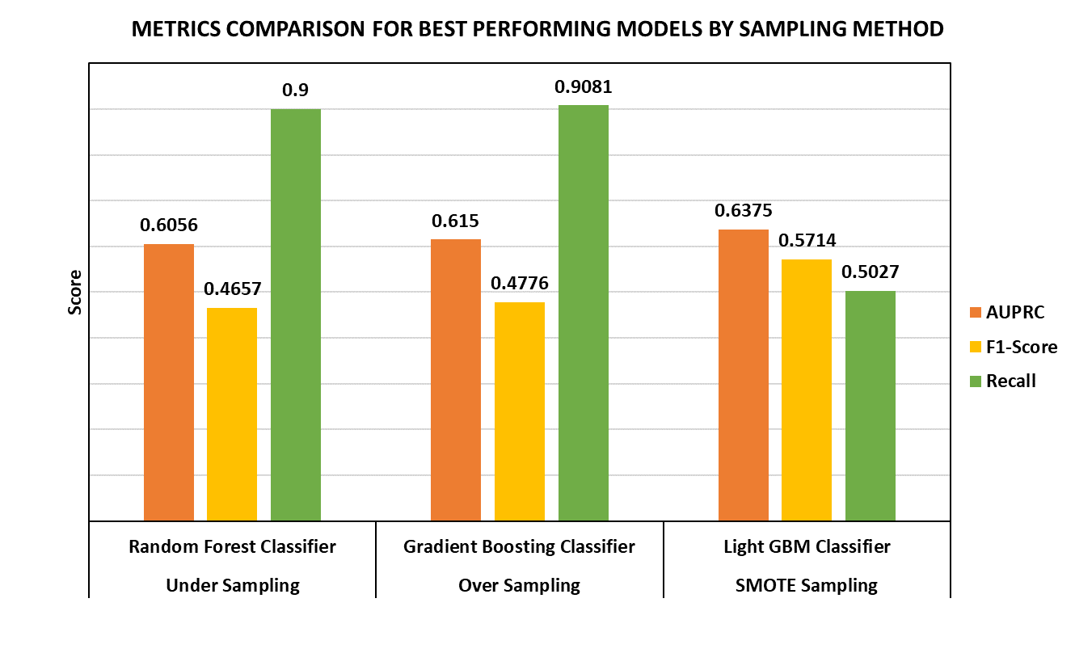
Evaluation
Gradient Boosting Classifier for the Over sampling technique offers the most balanced results having high AUPRC, F1-Score & Recall.
Important Features to guide simple rule formulation based on GBC are:
Age of First Use of Cocaine (COCAGE)
Hallucinogen Use Recency (HALLUCREC)
Arrest History (BOOKED)
Daily Cigarette use Age (CIGAGE)
Cigarette Use Recency (CIGREC)
Age of Marijuana First Use (MJAGE)

Slide 16
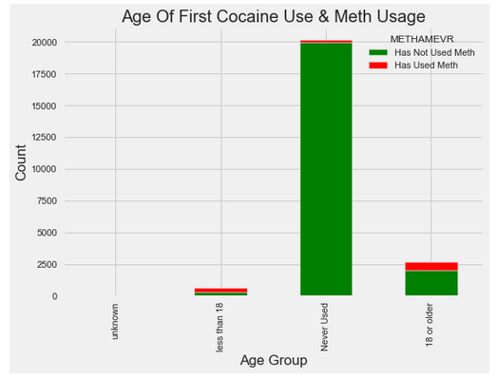
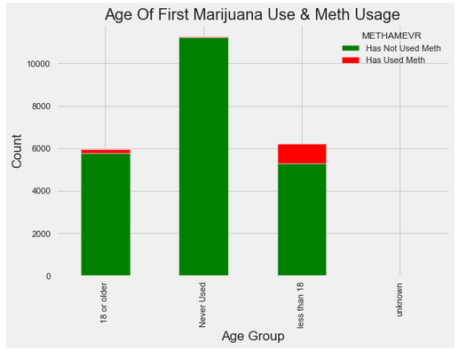
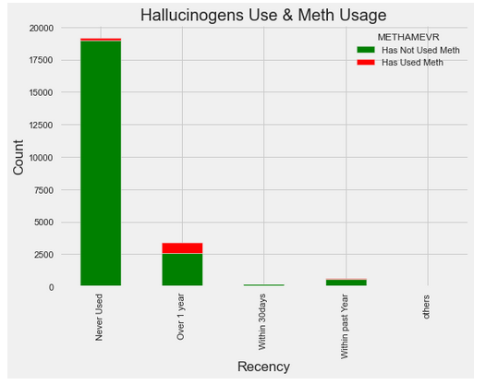
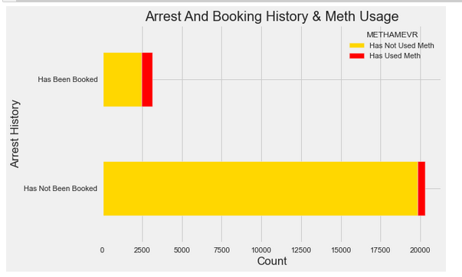
Discussion – Important Feature EDA

Slide 17
Discussion –Rule Formulation
Based on the Analysis of Some of the Key features we can formulate a 2 simple rules for easy identification of likely meth usage
User with early Marijuana usage history (<18 years), Adult Cocaine usage and Hallucinogen use within the past year more likely to delve into meth usage in mid 30’s to 40’s
User with no history of cocaine or hallucinogen usage and adult usage of marijuana less likely to delve into meth usage

Slide 18
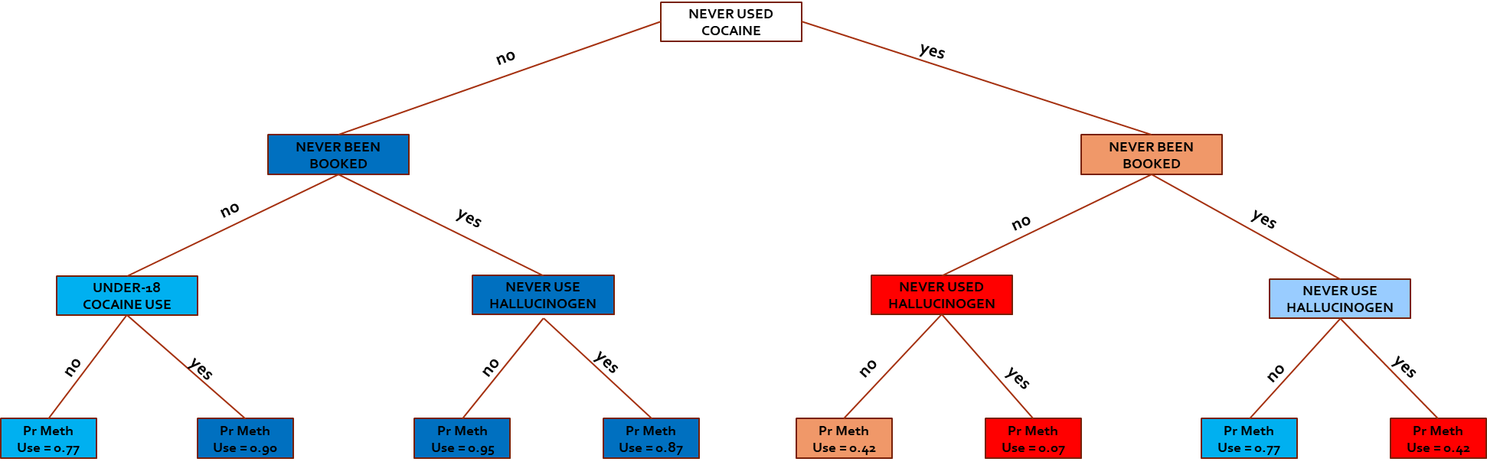
Discussion – Decision Tree Rule Formulation

Slide 19
Conclusion
This study has demonstrated the effectiveness of oversampling and tree-based ensembles in imbalanced classification problems
Through combination of model feature importance and EDA, simple rules have been identified that can help the U.S department of health identify likely meth users and perhaps make effort in reducing meth-related deaths
Underage Marijuana usage has been linked to adult meth usage and the U.S government may try to enforce restrictions to ensure no child marijuana abuse
For Further research on the topic, researchers may investigate societal influences that lead to meth usage

